Slide 1
CODE PINK
Mock Safety Call
By: Sue Lee, Sarah Lluberes, Kalena Wright, Bliena Tukue, Courtney Ross

Slide 2





Meet the team
Sue
Lee
Courtney
Ross
Kalena
Wright
Computer
Information
Systems,
Spring 2024
Computer Science,
Spring 2025
Mathematics,
Fall 2024
Bliena
Tukue
Sarah
Lluberes
Computer Science,
Spring 2025
Computer
Information
Systems,
Spring 2024

Slide 3
Agenda:
Introductory Slides: | Meet the team, Mission Statements
Problem & Solution: | Addressing the problem and pitch our solution.
App Features & User Interface: | Showcase the app features and application of this tool.
Competition & Market Analysis | Discussing the current market and relevant research.
Conclusion & Q&A | Team will answer relevant questions to the presentation.

Slide 4




Mission Statements:
Reprogramming higher education to create the most diverse generation of engineers.
Provide clean, safe, reliable and affordable energy is about more than our bottom line.
We ignite opportunity by setting the world in motion.
Helping more than 100 million U.S. families, friends and neighbors, plus nearly 2.5 million businesses, connect to greater possibility.

Slide 5
Problem:
Women's safety is a critical issue that involves various aspects, including personal safety, public safety, domestic violence, and more. One significant problem is that women often feel inclined not to escalate situations due to a variety of complex factors.
Meet us

Slide 6
Our Solution
Our Application:
We created an Application that will play an audio script and make it seem as if the user is on the phone.
Intention:
Our approach is centered around de-escalation and threat mitigation.
Intended benefit:
This application holds the capability to deter potential attackers and shield our users from prospective threats.
Notes:
Utilizing 5g

Slide 7
App Features:
The app will provide an array of scripted voice audios.
Users have the flexibility to select the audio that best suits their needs, depending on the situation.
As artificial intelligence becomes more advanced,
we would hope to add an AI chat feature where the user would speak to the AI assistant in real time.
Voice Audio Feature
Future Development Prospects

Slide 8
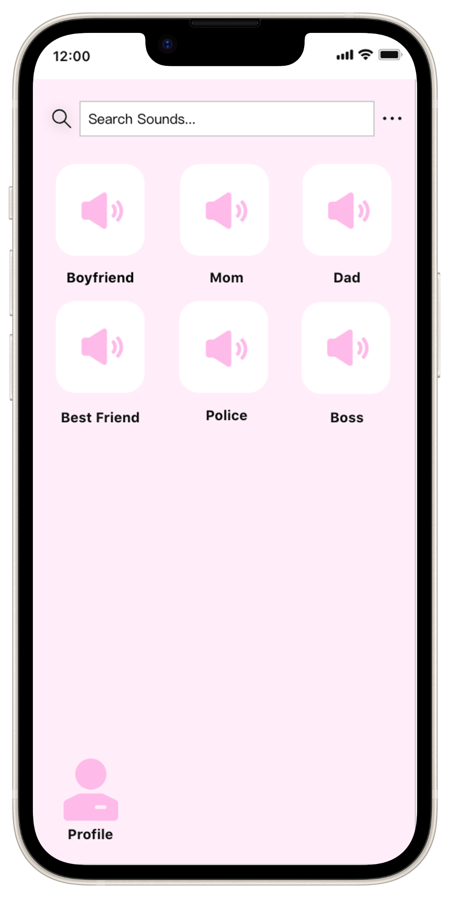
Application Example:
Sounds
Provides various audios to fit different situations.
Search Bar
User can utilize this feature to search for their preferred sound.
Profile
Includes account data, notification preferences, audio settings, etc.

Slide 9
What sets us apart?
Threat Mitigation
Tailored
Comfort
This app focuses on de escalating potentially dangerous or uncomfortable situations.
This app will cater to the users need and will have customizable features to fit any scenario.
Our goal is to provide users with a peace of mind and comfort in these situations.
Notes:
Faster network, at&t expand upon the features

Slide 10
Market Analysis:
Target Audience:
Women (Ages: 16-35)
Women Specific App, But Open To Everyone
Competitive Landscape:
No Known Major Competitors
Niche Market
Market Trends:
Reactive Measures -> Preventative Measures
Creating Holistic Safety Environments

Slide 11
Conclusion:
We confidently believe our application brings a unique and innovative perspective to women's safety.
Our emphasis on de-escalation will aid in prevention of crimes and protection of our users.

Slide 12
Q&A

